Slide 1
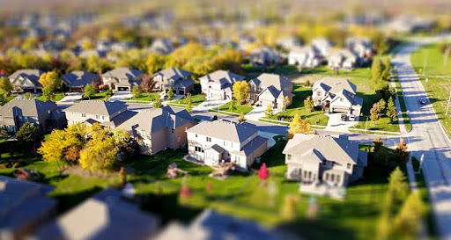
Sustainable Cities
Explore sustainable cities.
LO. I can understand populations living in urban environments

Slide 2
Which city is this?

Slide 3
Tokyo is a Mega-City…which means it has a population of over 10 million people. Tokyo has a population of 37.393 million residents. 13.5 million of these people live centrally.

Slide 4
Tokyo is BIG; why live there now?
Greater Tokyo is the world's most populous metropolitan area and is the centre of Japanese culture, finance, and government, this also means there are more jobs
There are arts and culture everywhere; even in busy Tokyo, there are shrines and temples everywhere. The religious spots of Shinto and Buddhism, and they are best suited in secluded nature areas
- Public transportation is excellent. Trains and buses are usually the vehicle of choice. Some train lines run every four minutes or less. And the trains go about everywhere. It is also a world economic and industrial centre.
- The city boasts a large number of world-class institutions of higher education notably the highest concentration of universities in Japan
- Although the city is so large, it has a very low crime rate and a respected police presence
- As well as lots of architecture and tall buildings, the city also has beautiful parks and recreation areas

Slide 5
Is this city sustainable?
What do we understand by sustainable?

Slide 6
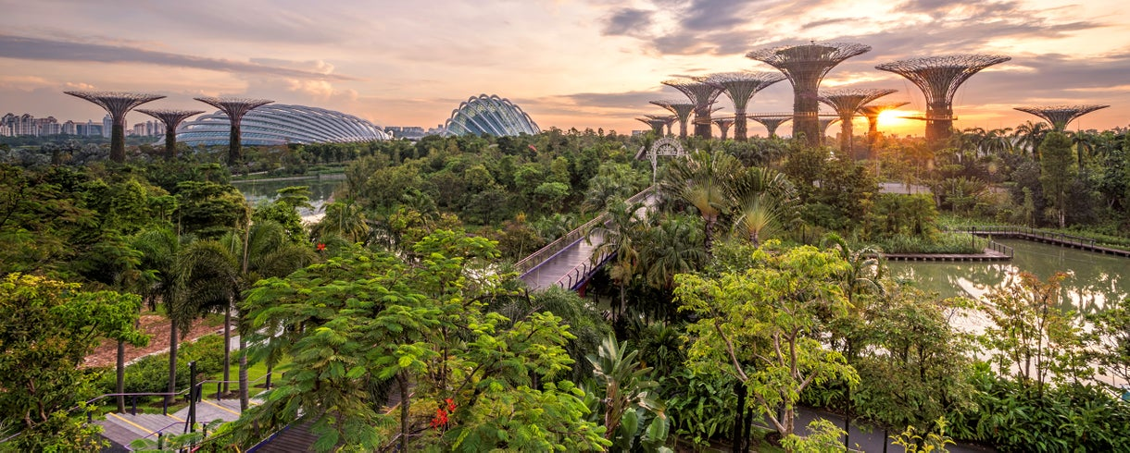
Sustainability means that a process, resource or state can be maintained at a certain level for as long as is needed.
What does that mean for our cities?

Slide 7
We need solutions…
The good news is that while cities are particularly at risk from the climate crisis, they are also behind some of the most powerful solutions. That’s why we’re taking a look at three sustainable cities in the world and the steps they’ve taken to become leaders in clean energy and climate solutions.

Slide 8
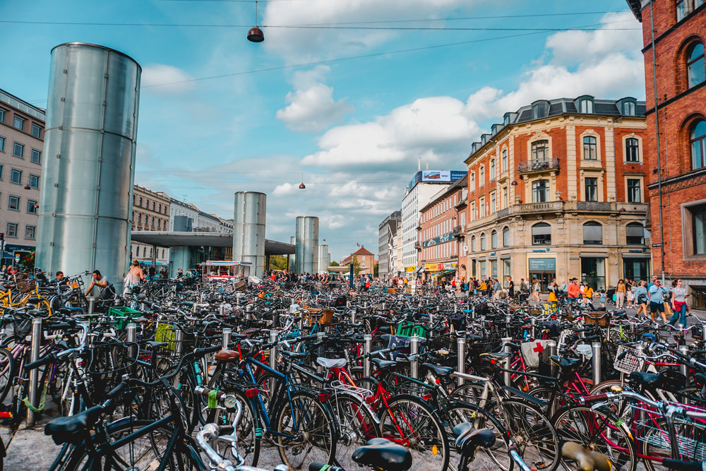
COPENHAGEN, DENMARK Copenhagen is often ranked as one of the greenest cities on the planet. Why? For starters, in 2009 the city set a goal to become the world’s first carbon neutral capital by 2025. Copenhagen has focused on reducing energy consumption in a variety of ways, including using an energy-efficient district heating system that connects to nearly every household and innovative cooling systems that save around 70 percent of the energy compared to traditional air conditioning. Copenhagen has also focused on reducing emissions and improving the health of its residents by improving mobility, integrating transport, and building what’s known as a super cycle highways. Super cycle highways and other bike lanes around the city have led to 45 percent of the city’s residents commuting by bike every day.

Slide 9
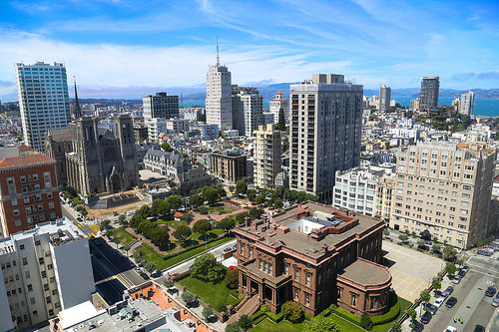
SAN FRANCISCO, CALIFORNIA
It’s no secret that San Francisco and the surrounding Bay Area are a serious tech-hub and home to some of the most innovative companies in the world, including Salesforce, Airbnb, Uber, and Twitter. Innovations in technologies to improve energy efficiency in buildings and enhance its transportation system make San Francisco a leader in sustainability and clean energy. It’s not uncommon to see hybrid-electric buses driving down the city’s streets.
The Bay Area has also cut its water consumption drastically in recent years. As California has battled serious droughts, San Franciscans have reduced their water consumption.

Slide 10
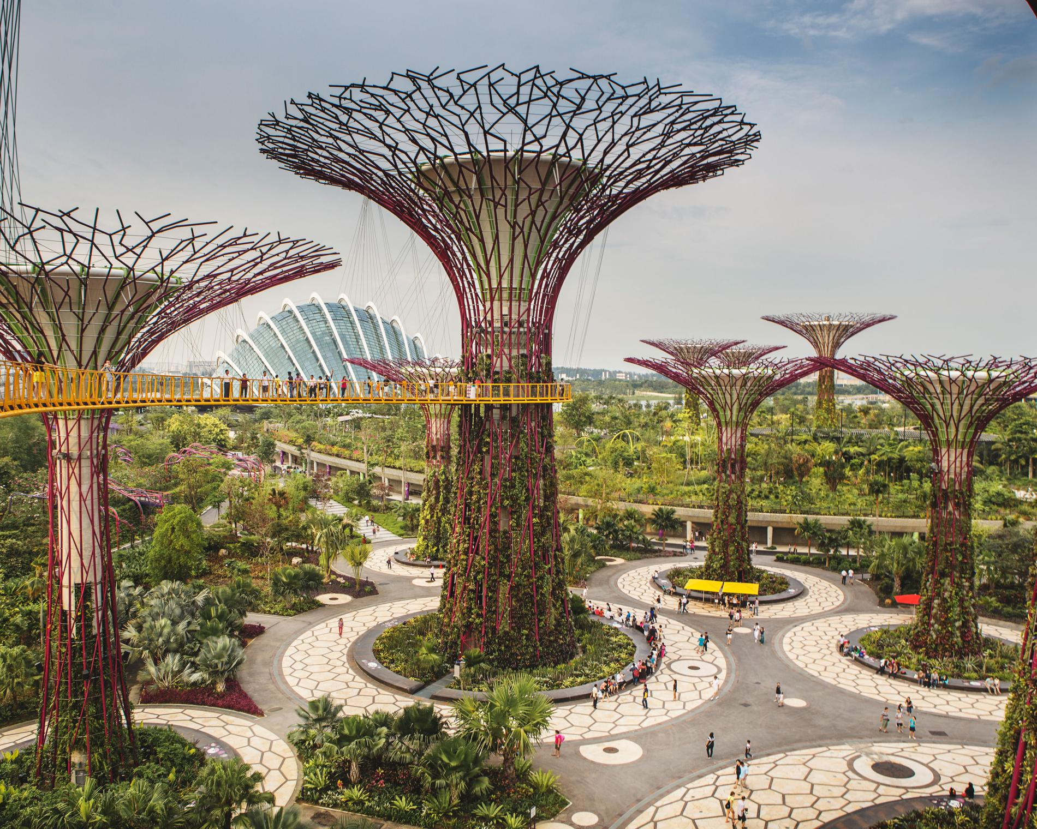
SINGAPORE
With a population of more than five million people, Singapore is one of the most forward-thinking green cities in Asia. The city-state has developed a Sustainable Development Blueprint, which outlines sustainability goals leading up to 2030. The targets include improving energy efficiency by 35 percent, ensuring 80 percent of its buildings are certified green, and having 80 percent of households be within a 10-minute walk to a train station.
Singapore has also improved its sustainability by making drastic changes in transportation. The city-state limits car ownership among its residents and has built effective public transportation systems, which has helped reduce pollution and crowding on streets and highways. Singapore’s public transit system helps residents navigate the city, along with biking and walking.

Slide 11
Think about all of the good things from those cities we have just looked at and what we've learnt from our visitors – what would you use in your planning for a sustainable city?
Note down any initial ideas you would like to magpie.

Slide 12
YOUR TASK
In groups, design a sustainable city
Apart from the needs of the people living there, you must consider the following things: energy, food, transport and nature

Slide 13
Energy
What have you used today that requires energy?
Even today we use a lot of fossil fuels, like oil coal and gas. In the past 200 years we have used over two thirds of the world’s resources already.
How will your city be powered?
YOU MUST TRY TO MAKE YOUR CITY RUN ON ONLY RENEWABLE ENERGY SOURCES- SOLAR, WIND, WATER, BIOMASS

Slide 14
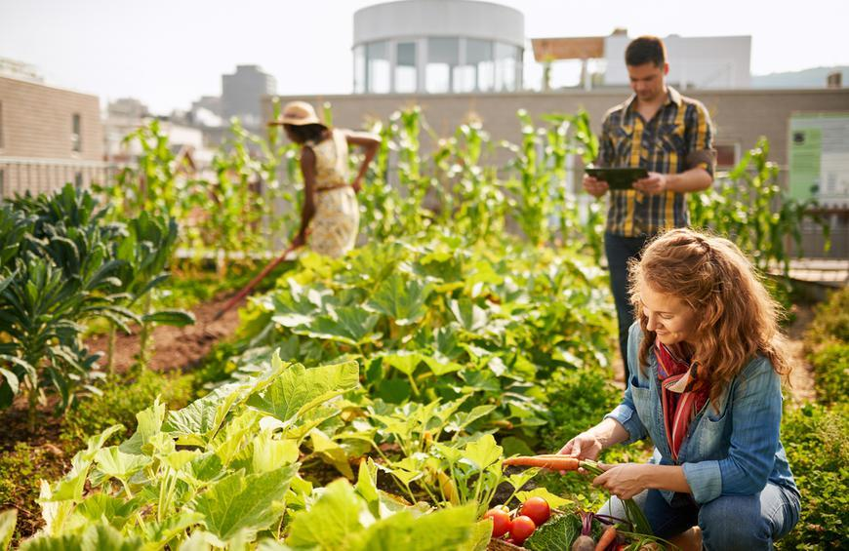
Food
What have you eaten today? Where did that food come from?
The more people there are the more food we need, but where will it all come from? Transporting food from far away is expensive and pollutes the environment.
How will you grow enough food, and make sure as little gets thrown away as possible?
YOU MUST TRY TO MAKE YOUR CITY RUN ON AS MUCH LOCALLY-SOURCED FOOD AS POSSIBLE

Slide 15
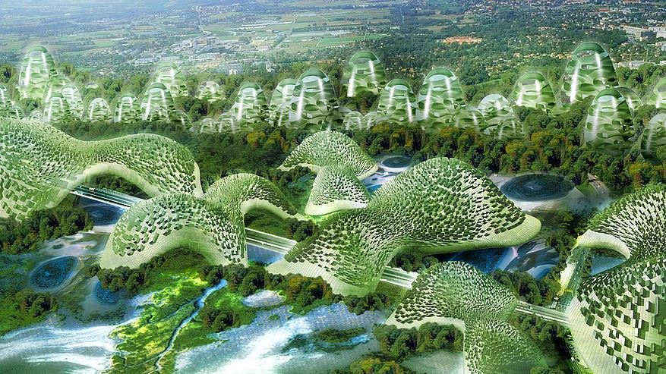
Nature
Humans are not the only living things in order for our survival we need to make sure our plants and animals can prosper. Green areas in your city are important not just for humans but you will need to help wildlife move around your city on ‘wildlife corridors’. Wildlife Corridors are areas of planting that help the green areas in your city link up for wildlife. It may be some plants on the edge of a road, or even people’s gardens. It won’t be just vegetables you will need to grow, flowers provide valuable nectar for pollinators which will in turn increase your food crop. It has also been proven that if people can see nature every day, and not just buildings, they are much happier and healthier.
Try and think of why you might need different plants and animals, this will help you make sure you have it in your city.
YOU MUST HAVE ROOM FOR NATURE IN YOUR CITY AND AIM FOR NO LESS THAN 30% GREEN SPACE

Slide 16
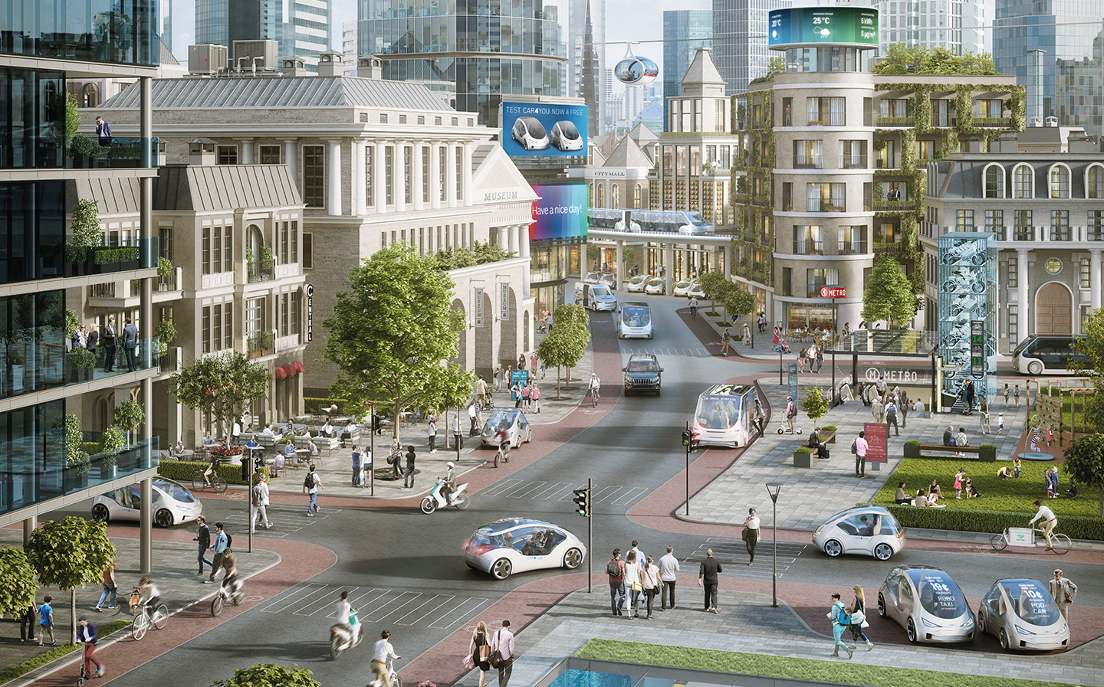
Transport
The way your population moves around the city is crucial for city living. Singapore aimed to ensure 80% of its population lived within a 10 minute walk of a train station. This needs to be carefully designed. Cars, buses, trains and trams, boats on rivers as well as walkways for pedestrians and lanes for cyclists will all play a part. Some of the largest cities in the world have even moved their transport out of the way using underground trains and elevated monorail systems e.g. Las Vegas has motorways underneath it’s buildings.
What will transport look like in your city?
YOU MUST TRY TO MAKE CARS THE LEAST-USED MODE OF TRANSPORT IN YOUR CITY

Slide 17
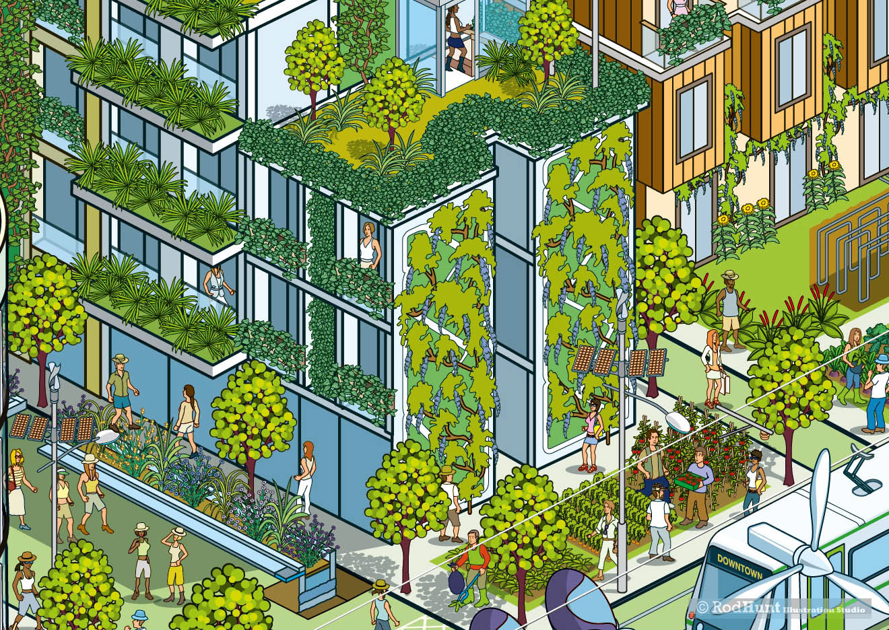
Now you are armed with the information and the right questions it’s your turn…
Your task for today is to design a 2-D plan – decide what you need to include in your sustainable city, and what the inhabitants of your city need to live there.

