Slide 1
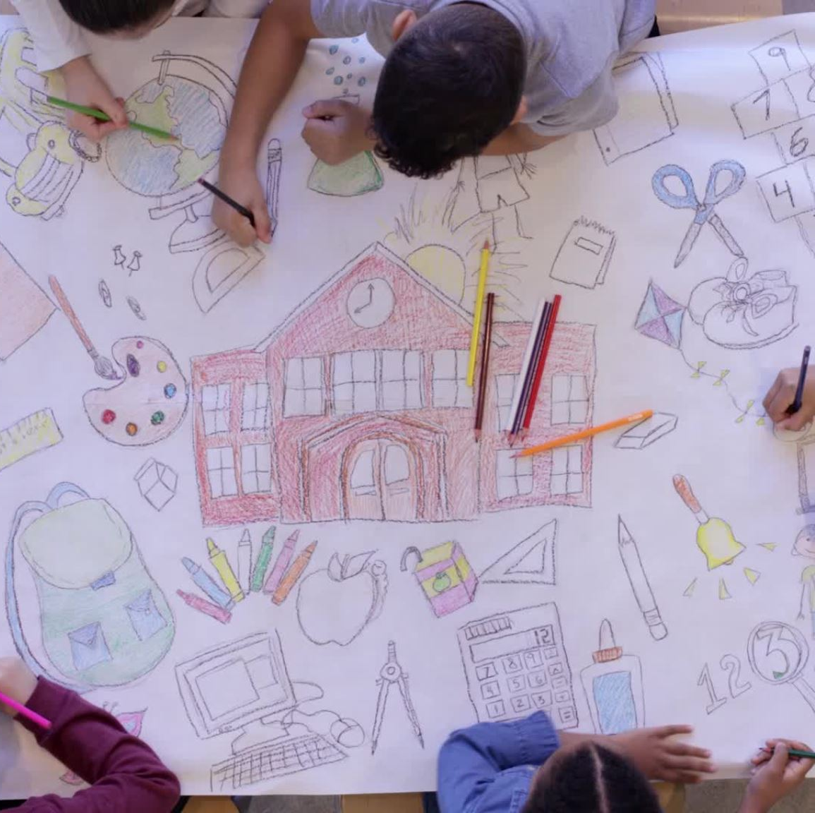
Project-Based Learning

Slide 2
What is project-based learning? Project-based learning is a child-centred pedagogy that involves children actively exploring real-world challenges and problems.
Why use project-based learning?
Increases engagement
Gives children ownership
Gives learning purpose
Helps children retain more
Employs modern, real-world skills
Empowers children- they see that they can make a difference!

Slide 3
how to implement it- the driving question
States a real-world problem or challenge
Guides pupils through the entire experience
Must be interesting and sustain children's attention
Must move towards the final goal/outcome/product
Needs to be an open-ended question

Slide 4
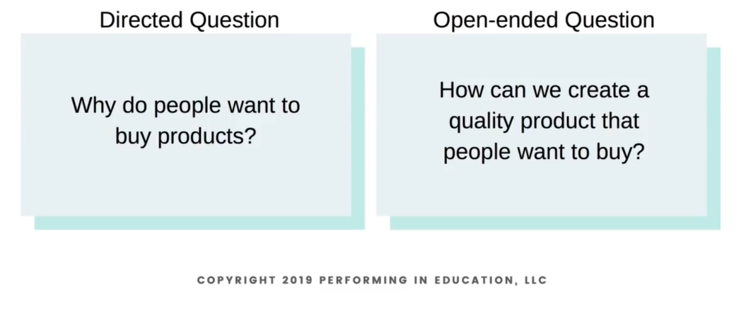
how to implement it- the driving question
See Appendix A for a formula

Slide 5
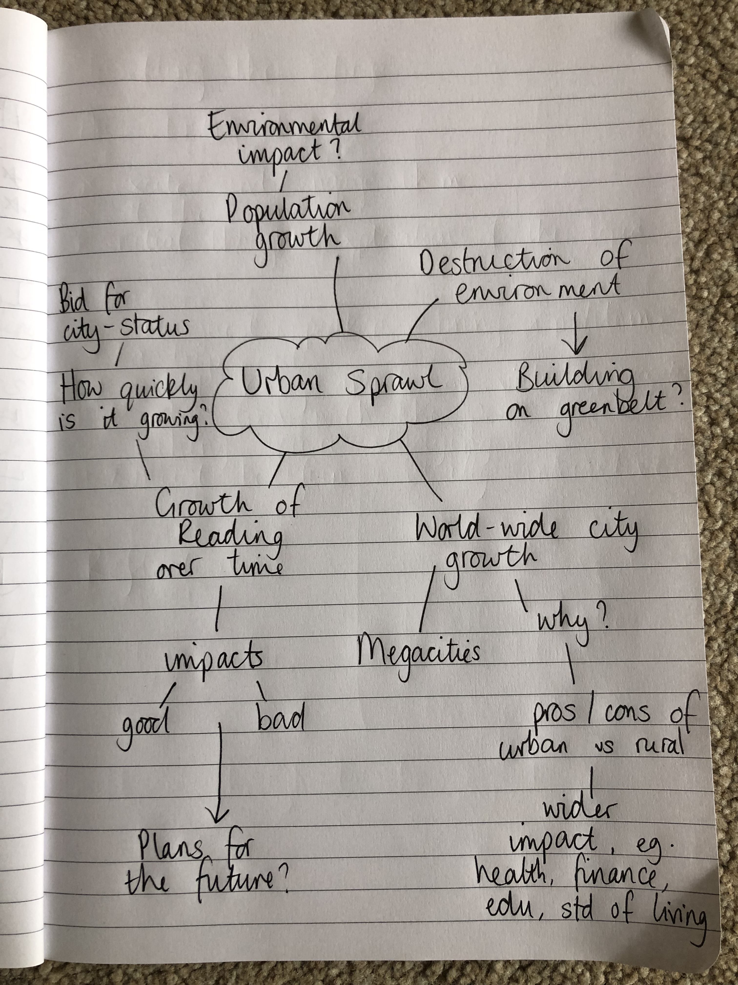
How to implement it- the planning process
1. Brainstorm- What's the topic? What skills or knowledge do you want to cover?

Slide 6
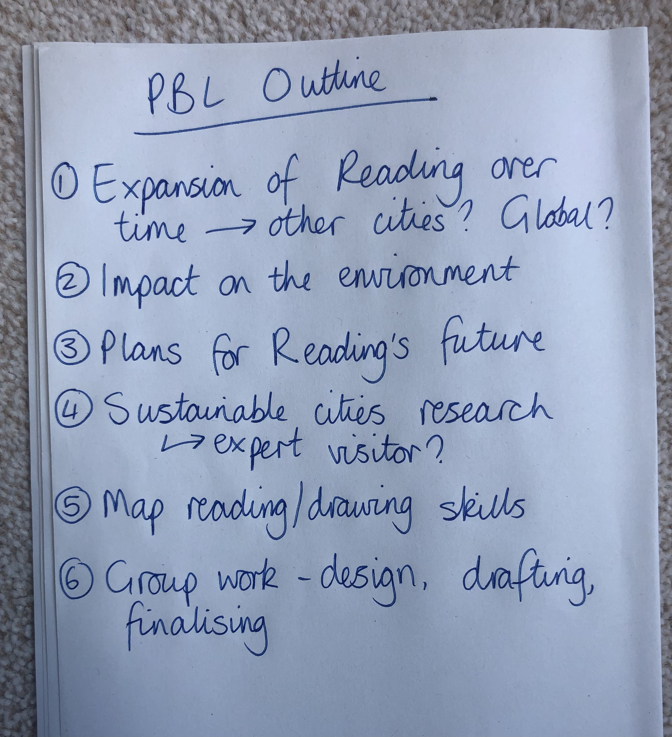
How to implement it- the planning process
2. Break down your brainstorm into a step-by-step outline.

Slide 7
How to implement it- the planning process
3. Create a flexible timetabled plan.

Slide 8
How to implement it- the planning process
Things to consider:
Keep in mind the level of scaffolding required whilst planning
You may need to factor in discrete 'skill lessons'
Keep it simple- use tools you're already familiar with like your LTP
Constantly keep learning outcomes and your curriculum in mind and link it to real life
Make as many inter and intra-subject curriculum links as possible
Collaborate with others

Slide 9
How to implement it- setting the stage
Try to start with an 'Entry Event'
Examples: a guest speaker, a trip out, a provocative article or video
It must:
Excite and engage
Set the scene
Be an initial exploration of the topic
Be interactive and involve the person/place/thing you are studying
Be fun!

Slide 10
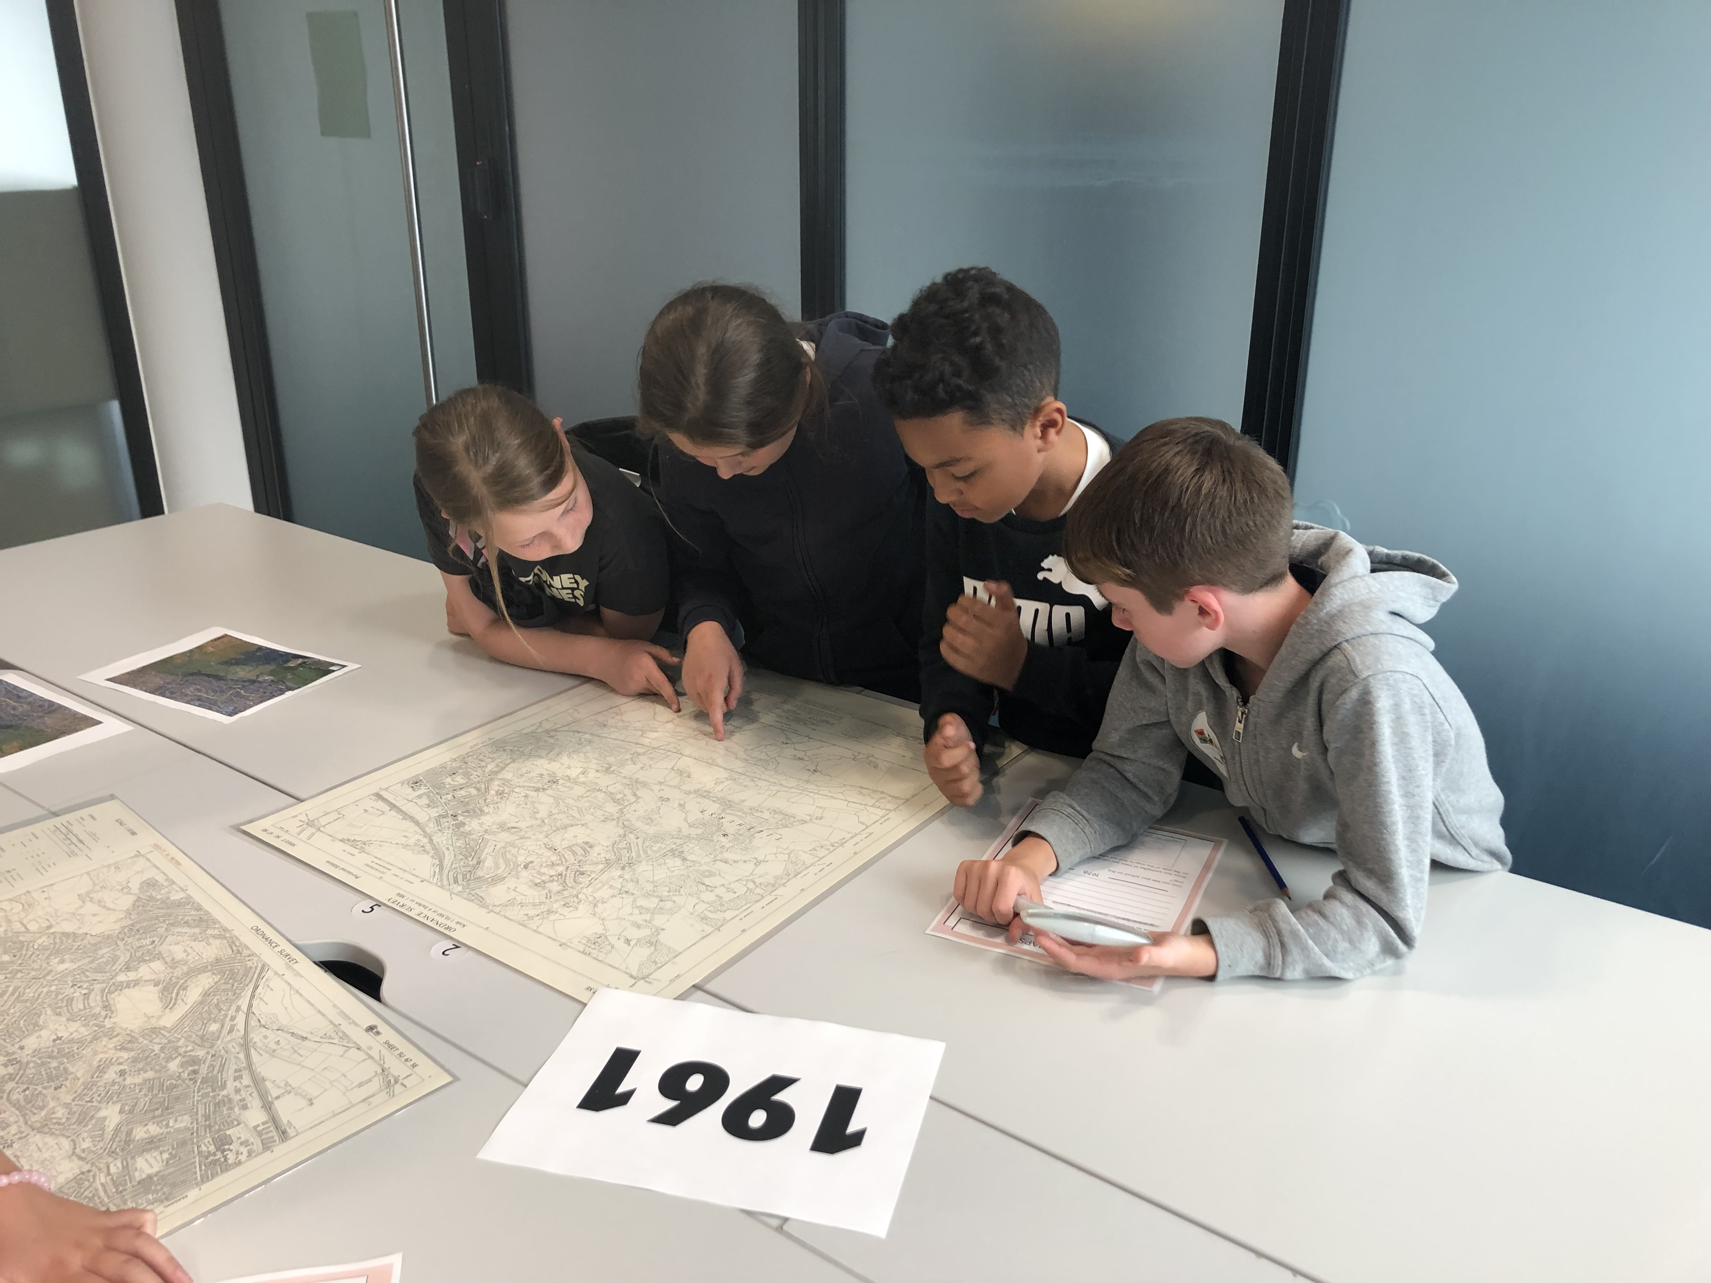
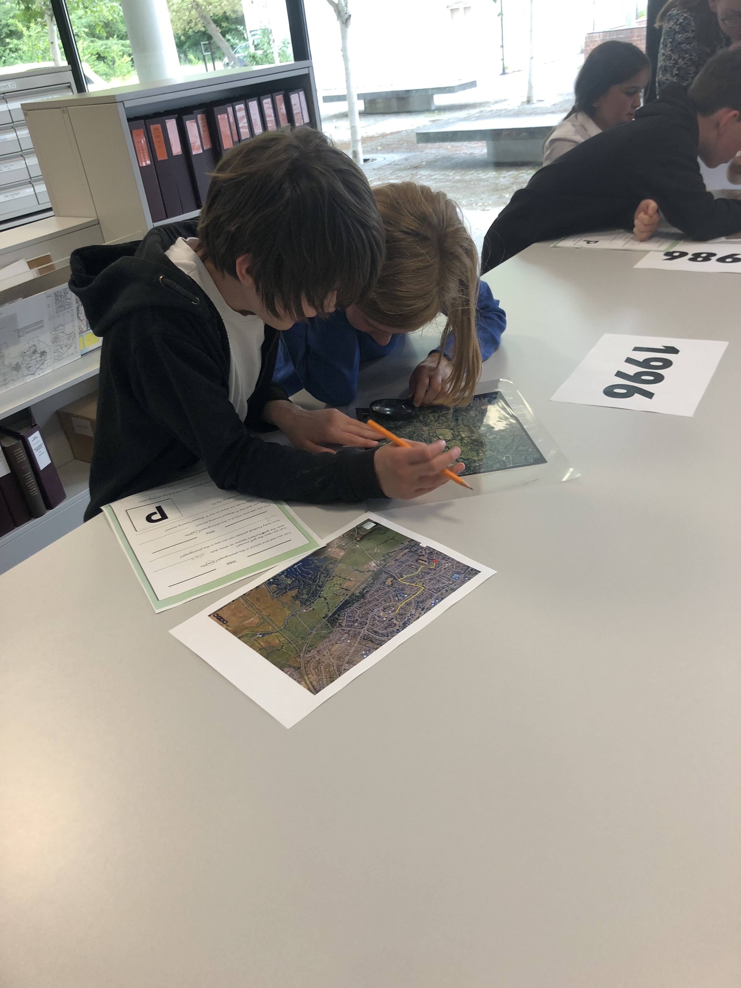
How to implement it- setting the stage

Slide 11
How to implement it- voice and choice
A fundamental part of PBL- children have autonomy and ownership
Will still need to be heavily scaffolded if they are new to PBL or very young
You must know where you want it to go, the skills and knowledge to cover, the activities along the way
Allow children to share their ideas and make choices within your framework
Let them prioritise the elements of the project they want to work on- not every outcome has to be identical
Ensure you are flexible!

Slide 12
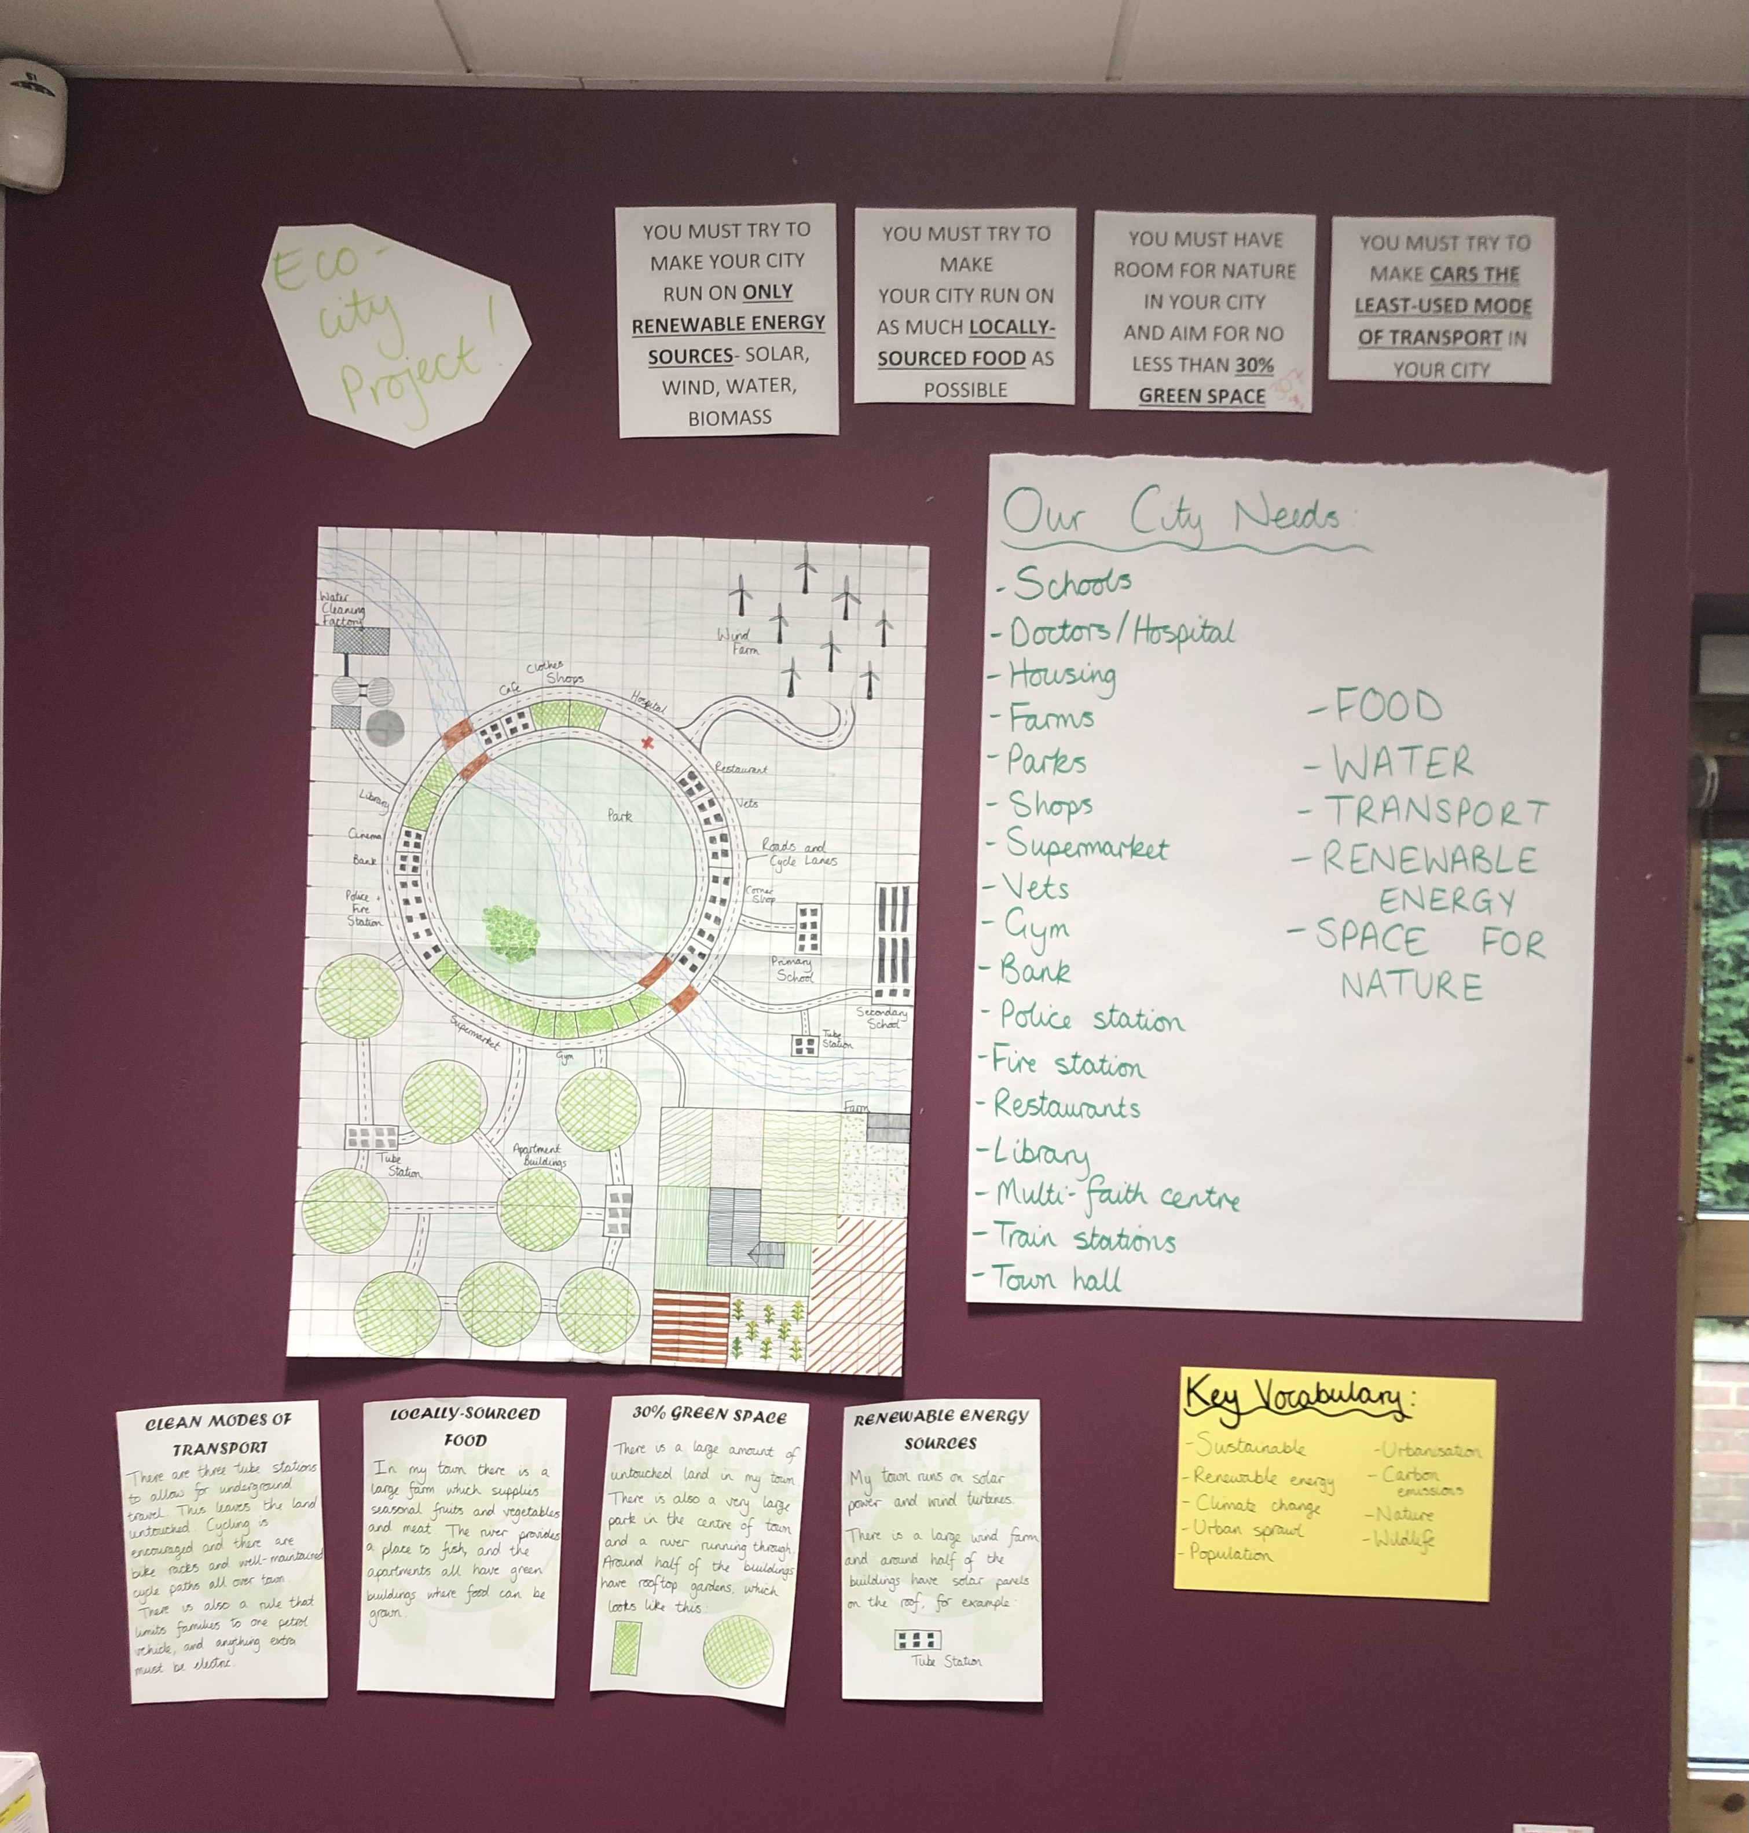
How to implement it- scaffolding and resources
Have a project learning wall or display
Some resources should be given by you
Some resources should be found by the children

Slide 13
How to implement it- scaffolding and resources
Consider both the skills and knowledge
Pre-teach vocabulary
Offer sentence stems or language models
Create opportunities for student discussions
Provide graphic organisers
Supply models and examples
Notes:
Skills- map drawing, calculating scale

Slide 14
How to implement it- Critique and revision
Should be built in throughout the project, not just at the end
Should allow children to edit and improve their work, even the final product
Accessible at all ages: https://www.youtube.com/watch?v=E_6PskE3zfQ
Helpful feedback | Authentic Feedback
Teachers Peers Family members | Intended audience Experts in the field Local groups/universities

Slide 15
What should the outcome be?
Can all be the same or different
It must be closely linked and relevant to the topic
It could be produced as a group (younger) or by an individual (older)
Should be shared publicly
Suggestions:
Presentation/talk
Exhibit
Song
Movie
Podcast
App
Website/webpage
Event
Scrapbook/journal
News/magazine article
Business proposal
Maps
Blueprints
Artwork
Mock event (eg. trial)

