Slide 1
The Greek Educational system
Between the Green & the Blue: an environmental study to assure our future

Slide 2
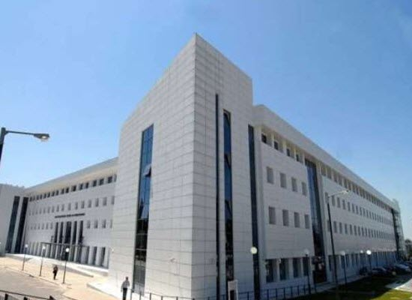
.
The educational system in Greece is administered by the Ministry of Education and Religious Affairs. The Ministry exercises centralized control over public schools including dictating curriculum, appointing staff and controlling funding

Slide 3
.
Public Education in Greece is free. The books provided to students are free, as well.
Education is compulsory for all children between 4-15 years.
All the educators are university graduates

Slide 4
The system is divided into three levels
1. Primary education (4-12)
2. Secondary education (12-18)
3. Tertiary education (18+)

Slide 5
.
There are infant/child centers for the children of the age of 2 months to 4 years old that they are within the competence of municipalities and the Ministry of Labour and Social Affairs.

Slide 6
Primary
Kindergartens 4-6 y.o-Nipiagogeio in greek
Primary Schools 6-12 y.o-Dimotiko in greek
Secondary
Junior High School-Gymnasio 12-15 y.o.
Senior High School-Lykeio 15-18 y.o.
Compulsory
Tertiary
University 18+

Slide 7
1. Primary education is divided in 2 sub categories
Primary
education
Kindergarten
Primary
Kinder
garten
All-day Kinder
garten
Duration: 8:15 a.m.-13:10 p.m.
The students are taught general education subjects such as Language, Maths, Science, P.E, Music, Art, Theater, Geography
One teacher per class
Compulsory
One teacher
per class
Optional
Duration:7:45 a.m-16:00 p.m
Common classes in the mornings, less learning activities in the afternoon

Slide 8
1. Primary education is divided in 2 sub categories
Primary
education
Kindergarten
Primary School
Primary
School
All-day Primary
School
Duration: 8:15 a.m.-13:15 p.m.
The students are taught general education subjects such as Language, Maths, Science, History, Mythology, Music, Art, Theater Geography
One main teacher & specialties teachers
Compulsory
One teacher
Optional
Duration:7:45 a.m-16:00 p.m
Common classes in the mornings, extra learning activities on Music, Art & Physical Education in the afternoon, time for doing homework

Slide 9
Types of Kindergartens & Primary Schools
Experimental Schools
Cross-Cultural Education Schools
Special needs Schools
Minority Schools
Reception Structures for the Education
of Refugee Children

Slide 10
2. Secondary education is divided in 2 sub categories
Gymnasio
It lasts 3 years from the age of 12 to 15. Provides general education
Lykeio
It lasts 3 years from the age of 15 to 18. Provides general education & vocational guidance courses.There are 2 types of lyceum: General & Vocational
Secondary
education
Compulsory
Non compulsory
Gymnasio
Lykeio

Slide 11
Other types of Secondary Schools
Experimental Schools
Music Schools
Evening Schools: Junior/ Senior High/Vocational Senior High Schools: they operate in the evening
Art Schools: they foster students who have a special interest in painting, drama, dancing
Ecclesiastic Schools: they are specialised in theological knowledge for pupils wishing to follow clerical professions
Cross-Cultural education Schools
Minority schools
Special needs Schools
Reception Structures for the Education of Refugee Children

Slide 12
PRIVATE sector
There are private schools in all basic aforementioned educational areas of primary & secondary education that are licensed & function under certain rules set by the Ministry of Education.

Slide 13
The students, in order to continue their studies in higher-tertiary education take part in national level exams, named Panellenies Hellas- Eλλάς/Ελλάδα Hellinic Republic

Slide 14
3. Tertiary
1. Primary education is divided in 2 sub categories
Tertiary
education
Universities-Polytechnic sch.- Sch. of Fine Arts
Postgraduate studies-Doctoral studies
University
Polytechnics
School of Fine Arts
The studies last 4-6 academic years, it depends on the faculty
Post-
graduate
Studies/
Doctoral
Studies
Duration of Postgraduate studies: usually 2 years
Duration of doctorates at least 3 years

Slide 15
Vocational Training Institutes
Schools of second chance
Lifelong Learning centers
Colleges
Lifelong Learning
Schools of second chance
Vocational Training Institutes
Lifelong Learning centers
Colleges

Slide 16
.
Lifelong Learning
For adult students of all ages
Lifelong Learning Centers
Second Chance Adult Education School
Vocational Training Schools
Vocational Training Institutes

Slide 17
Thank you for your attention!

Slide 19
